Slide 1
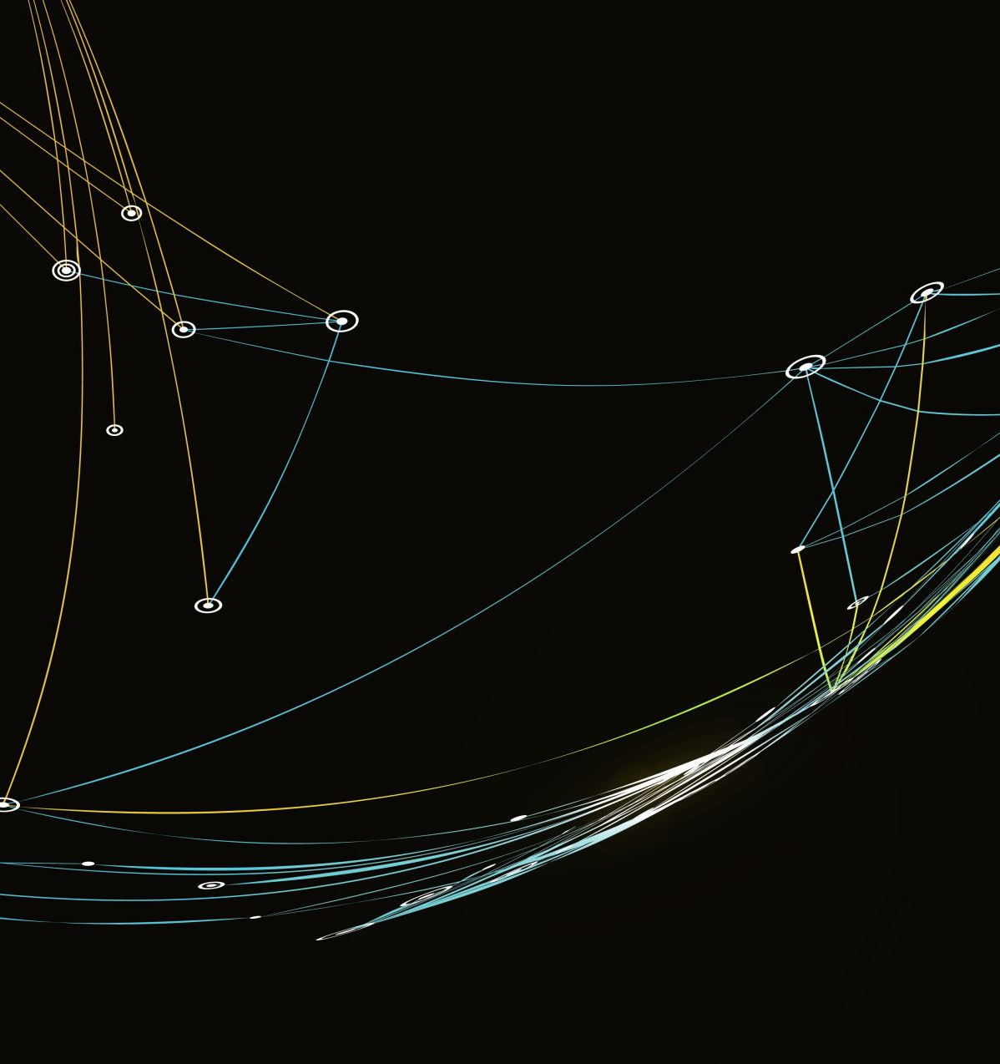
Contact Tracing with Body-worn IoT Devices
Middleware Technologies for DistributedSystems 2020/2021

Slide 2
Problem
Keep track of the contacts between devices
If an event of interest happens, inform all the contacts of a given device

Slide 3


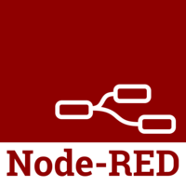

Architecture
Contiki-NG to manage motes
MQTT as communication protocol
Node-RED as back-end manager
Firebase as storage

Slide 4
Cooja
Project structure:
Event-driven programming pattern
01
Wireless propagation:
Constant Loss Unit-Disk Graph Model (CL-UDGM)
02
Routing:
Routing Protocol for Low-Power and Lossy Networks (RPL)
03
Motes:
Cooja motes
04

Slide 5
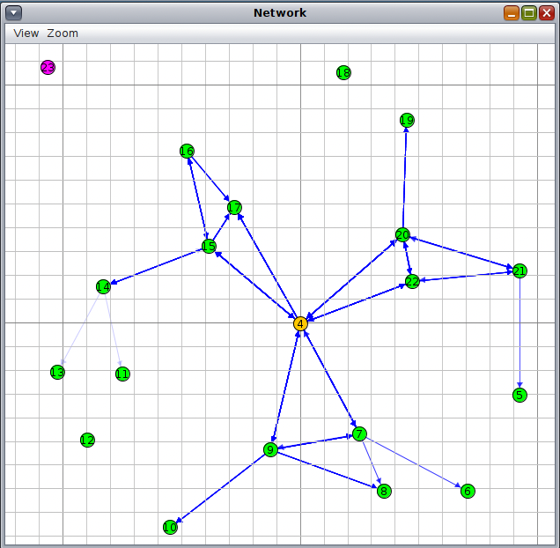
RPL Border-Router
Man-in-the-middle device
Destination-Oriented Directed Acyclic Graph (DODAG) root of the whole network
Allows communication with the internet

Slide 6
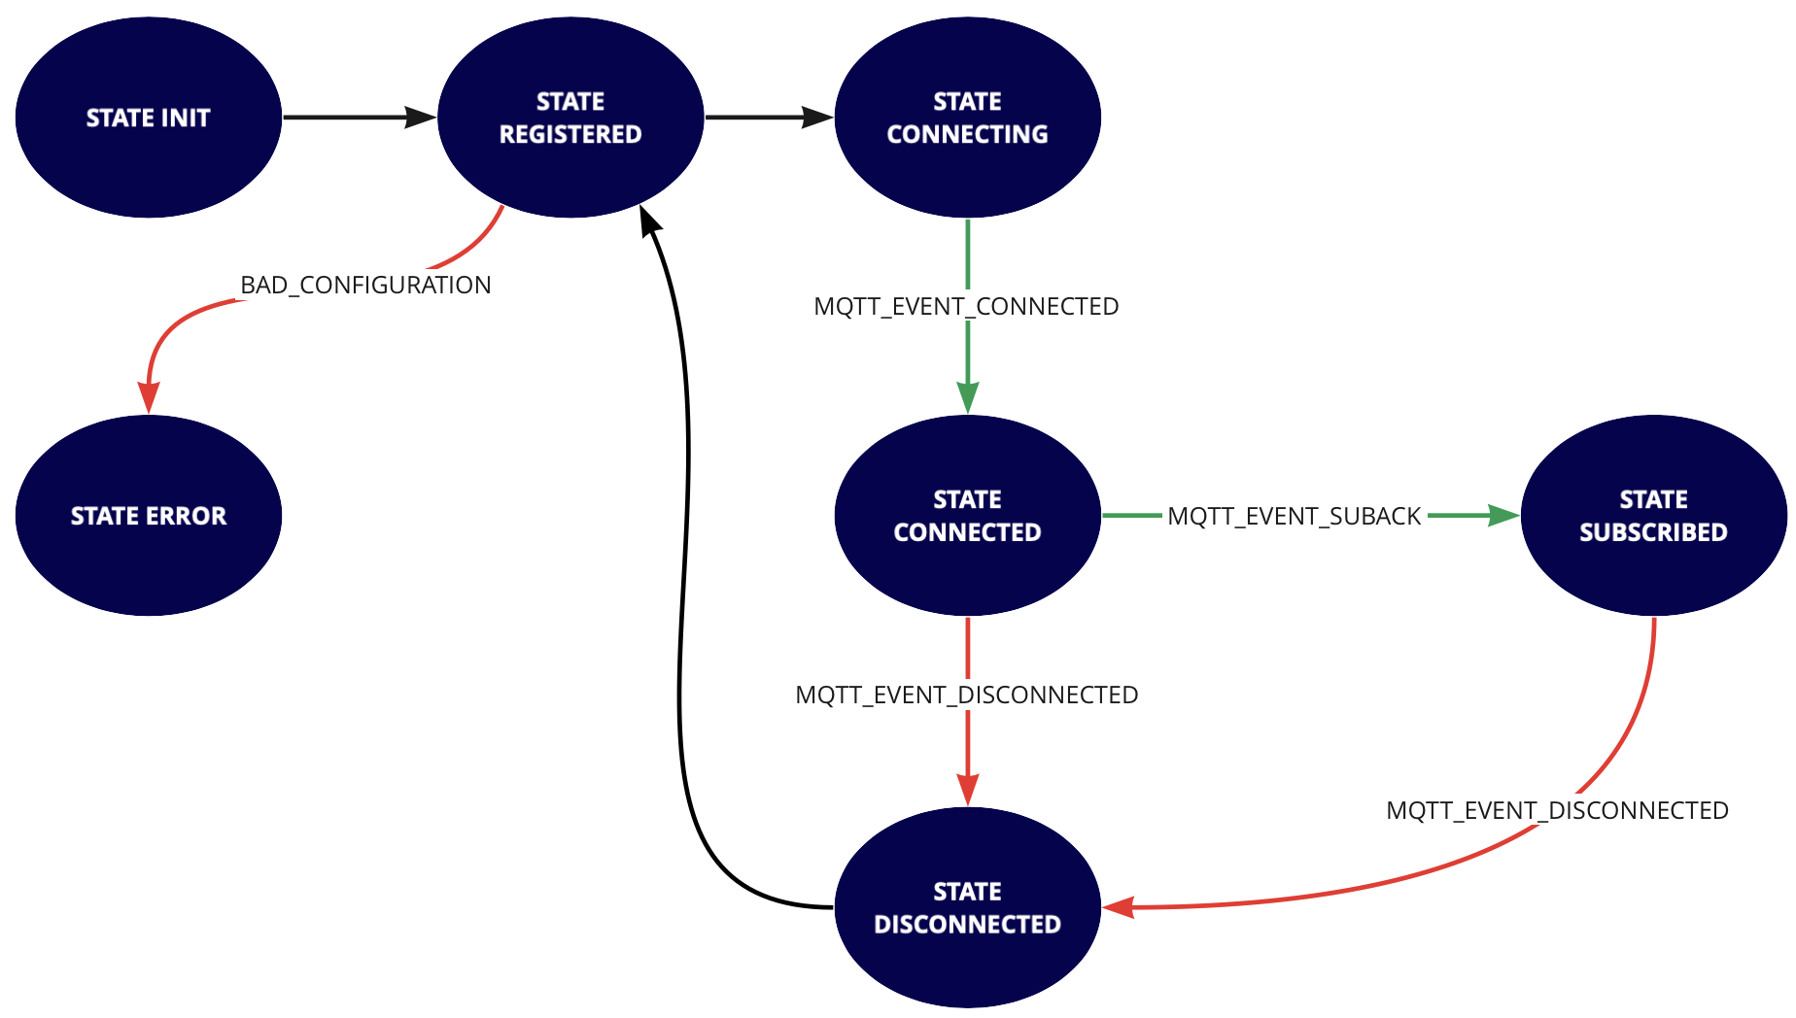
MQTT-UDP Mote
Protothreads to achieve parallel execution (UDP + MQTT)
MQTT as Finite-State-Machine
Publish-Subscribe pattern
Different topics for different communications

Slide 7
UDP Signaler
Device used to trigger events of interest
Multicasts a special message to all motes in its range
Triggers the publish of a special message used by the back-end

Slide 8
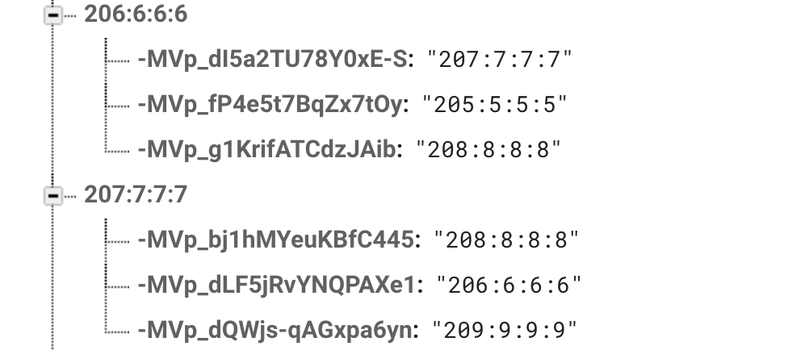
Database
NoSQL realtime database
First level dedicated to each node
Second level dedicated to all the contacts of that node

Slide 9
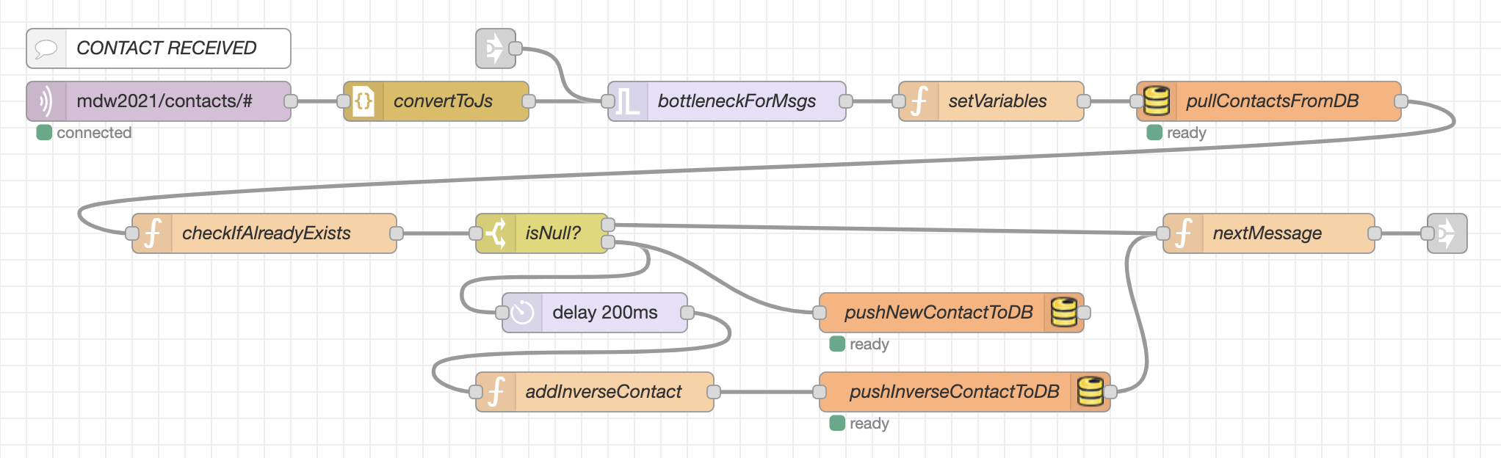
Node-RED – Contacts Flow
Multi level wildcard (#) to receive messages from all motes
MQTT QoS set at 1
Read the /contatcts/# topic
If the contact isn’t already in the Database, a pair it’s added in the contacts list of both members

Slide 10
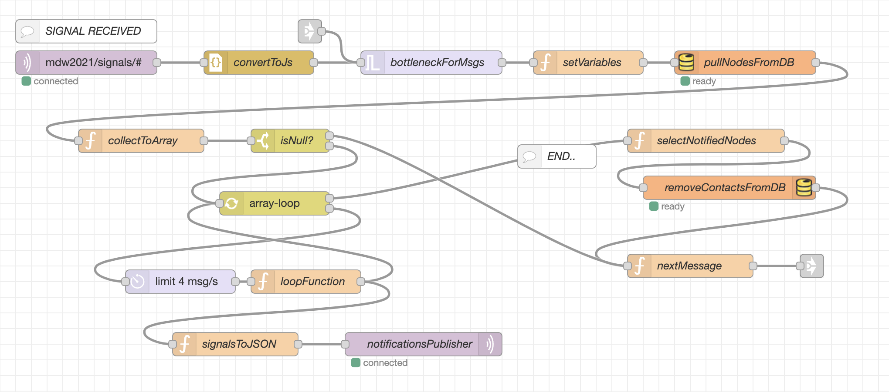
Node-RED – Signal Flow
Multi level wildcard (#) to receive messages from all motes
MQTT QoS set at 1
Read the /signals/# topic
Pull from the DB all the contacts of a given address
Publish a notification message on each contact
Dump the list of contacts

Slide 11
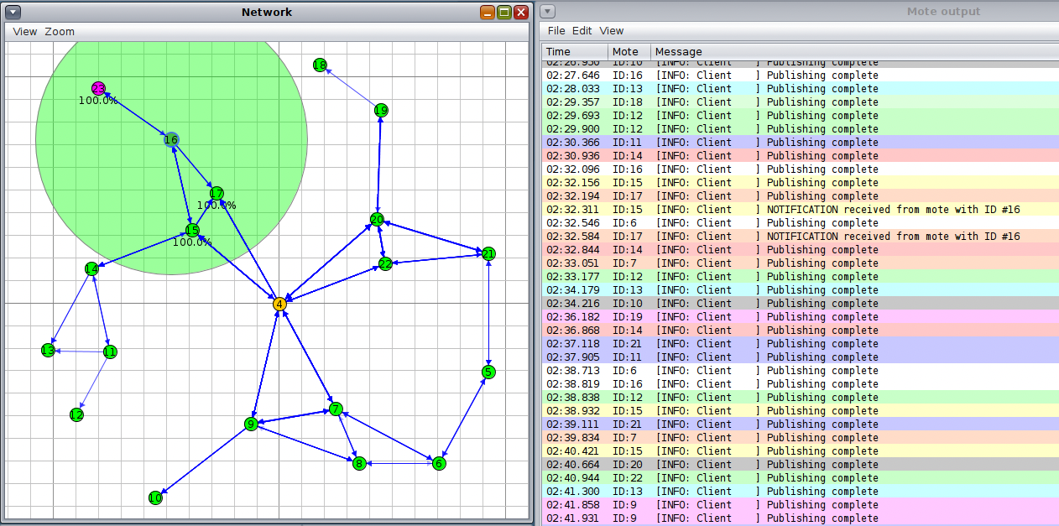
Testing & Conclusion
After some time the tree topology is created
Motes communicate and print «Publishing Complete»
Motes close to the purple one will signal the event of interest

